Slide 1

















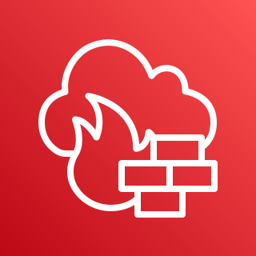


















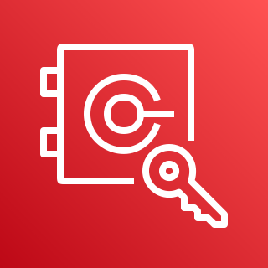



























AWS Cloud
Region
VPC
Availability Zone1
Auto Scaling group
Auto Scaling group
Web1
WAS1
Security group
Security group
Availability Zone2
Web2
WAS2
Security group
Security group
VPC
Monitor Group
Availability Zone1
Availability Zone2
BastionHost
RDS1
RDS2
Security group
Security group
Security group
Storage group

Slide 2
AWS Cloud
1
2
20
Region
VPC
Availability Zone1
3
4
21
Auto Scaling group
Auto Scaling group
Web1
WAS1
5
6
22
Security group
Security group
7
8
Availability Zone2
9
10
Web2
WAS2
11
12
Security group
Security group
13
14
15
16
VPC
Monitor Group
17
18
Availability Zone1
Availability Zone2
BastionHost
RDS1
RDS2
19
Security group
Security group
Security group
Storage group

Slide 3
 | AWS VPN
 | Amazon Simple Storage Service
 | Amazon GuardDuty
 | AWS Network Firewall
 | AWS Key Management Service
 | Amazon Macie
 | Amazon Inspector
 | AWS Security Hub
 | Amazon Detective
 | AWS Secrets Manager
 | AWS Single Sign-On
 | AWS CloudHSM
 | AWS Certificate Manager
 | Amazon Cognito
 | AWS CloudTrail
 | Amazon CloudWatch
 | Amazon Simple Notification Service
 | AWS Config
 | AWS Systems Manager
 | AWS WAF
 | AWS Identity and Access Management
 | AWS Management Console
1
12
2
13
3
14
4
15
5
16
6
17
7
18
8
19
9
20
10
21
11
22

